Slide 1
Deep Learning School 2
NLP
Артем Чумаченко

Slide 2
Что такое Natural Language Processing?
nlp = linguistic + machine_learning

Slide 3
Задачи NLP
Понимание текста
Генерация ответов на вопросы
Диалог
Перевод
Распознавание речи

Slide 4
Задачи NLP
Понимание текста
Генерация ответов на вопросы
Диалог
Перевод
Распознавание речи
Методы предобработки текста

Slide 5
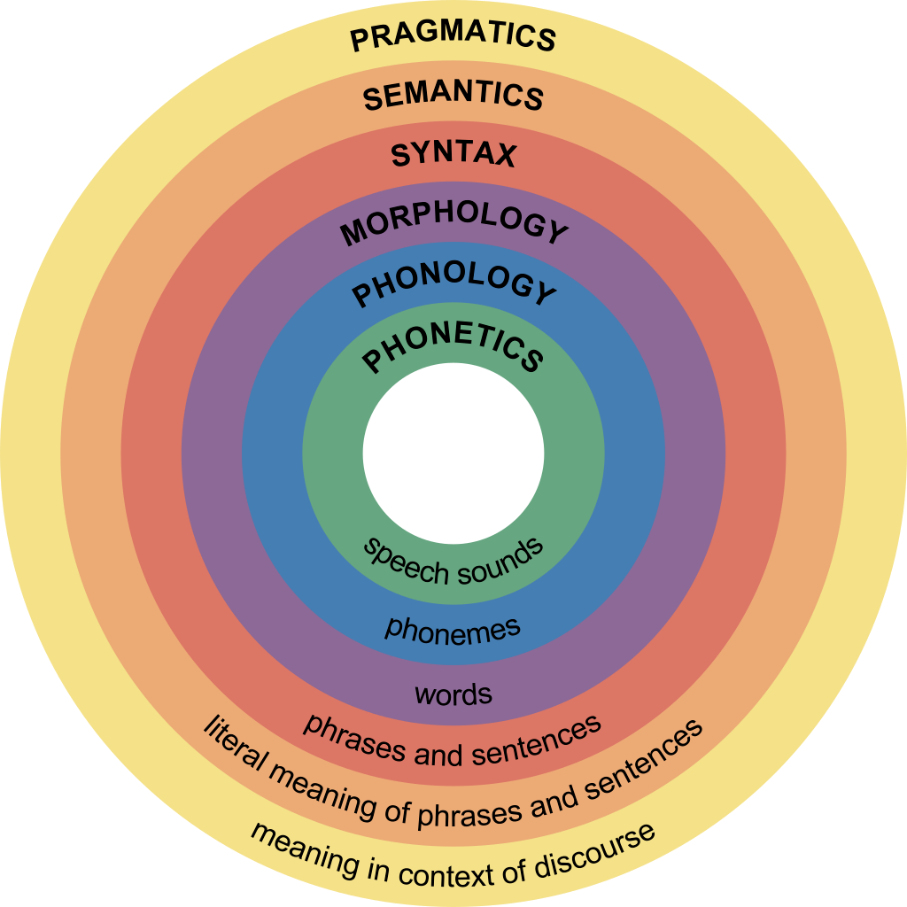
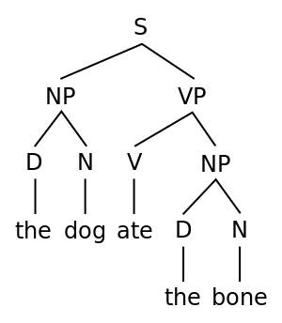
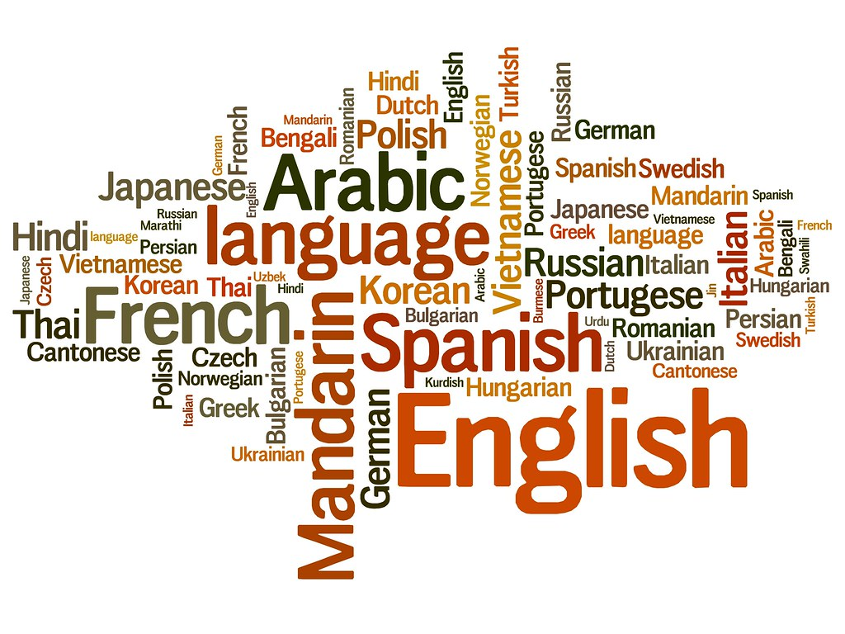
Лингвистика

Slide 6

А зачем ML?

Slide 7
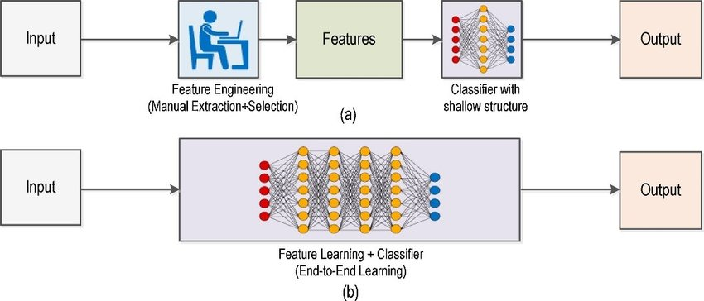
Тогда vs сейчас

Slide 8

Пример задачи: классификация текста
😀
😡

Slide 9
Используем слова
dictionary = union(text.split() for text in corpus)
word_in_texts = [
[word in text for word in dictionary]
for text in corpus
]

Slide 10
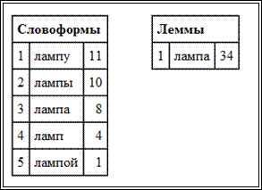
Лемматизация

Slide 11
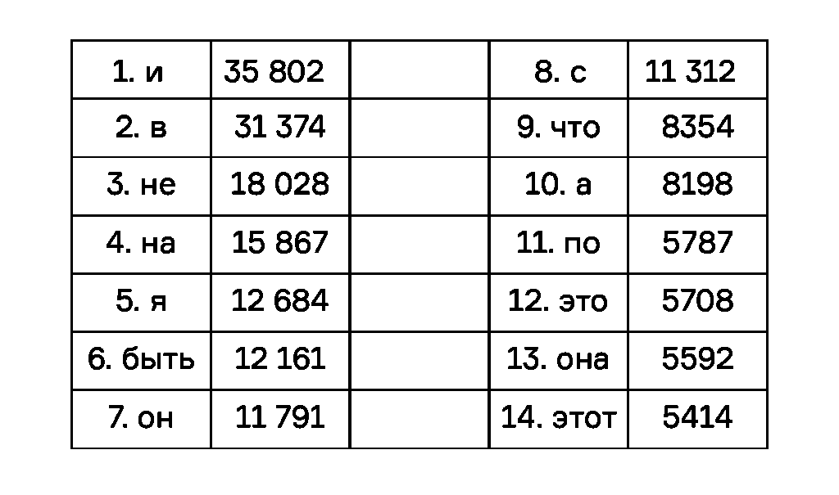
Частотность

Slide 12
Извлекаем признаки
dictionary = union(text.split() for text in corpus)
word_in_texts = [
[
word.normal() in text
for word in dictionary
if word.freq() < threshold
]
for text in corpus
]

Slide 13
Naive Bayes
P(text in C | words) = P(words | text in C) * P(C) / P(words)
P(words | text in C) = prod(P(word in C) for word in words)
P(words) = prod(P(word) for word in words)

Slide 14
Naive Bayes
log_P(text in C | words) = \
sum(log_P(word in C) for word in words) - \
sum(log_P(words) for word in words) + log_P(C)
prediction = argmax(log_P(text in C | words))

Slide 15
TF-iDF
dict = union(doc.split() for doc in corpus)
term_freq = [
[term.freq(doc) for term in doc]
for doc in corpus
]

Slide 16
TF-iDF
inv_doc_freq = [
log(
len(corpus) /
len(doc for doc in corpus if term in doc)
)
for term in dict
]

Slide 17
TF-iDF
tf_idf = [
[
term_freq[term] * inv_doc_freq[term]
for term in doc
]
for doc in corpus
]

Slide 18
TF-iDF + SVD
tf_idf = [
[
term_freq[term] * inv_doc_freq[term]
for term in doc
]
for doc in corpus
]
u, s, v = svd(tf_idf, n_components)
encoder = v

Slide 19
Синтаксис

Slide 20
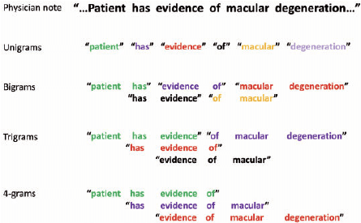
n-граммы

Slide 21
n-граммы
dict = union(
compose(doc.split(), n=2)
for doc in corpus
)
term_freq = [
[bigram.freq(doc) for bigram in doc]
for doc in corpus
]

Slide 22
Языковая модель
P(w_0,w_1,w_2) = P(w_0) * P(w_1 | w_0) * P(w_2 | w_0,w_1)
w_3 = argmax(P(w | w_0,w_1,w_2))
# if n == 3
w_3 = argmax(P(w | w_1,w_2))

Slide 23
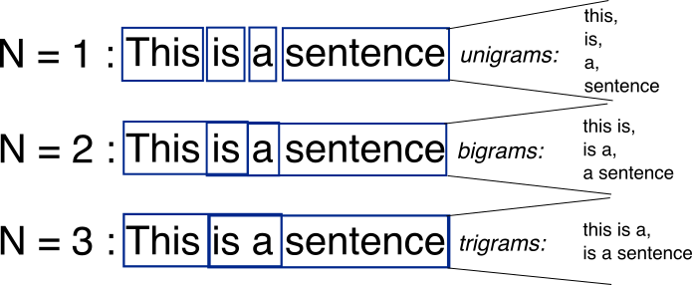
n-граммы

Slide 24
Проблема частоты слов
dictionary = union(text.split() for text in corpus)
word_in_texts = [
[
word.normal() in text
for word in dictionary
if (word.freq() < max) || (word.freq() > min)
]
for text in corpus
]

Slide 25
Pointwise Mutual Information
PMI(w, c) = log(P(w, c) / P(w) / P(c))
# if PMI(w, c) > 0, then P(w, c) > (P(w) * P(c))
# elif PMI(w, c) < 0, then P(w, c) < (P(w) * P(c))

Slide 26
Pointwise Mutual Information
PMI(w, c) = log(P(w, c) / P(w) / P(c))
# if PMI(w, c) > 0, then P(w, c) > (P(w) * P(c))
# elif PMI(w, c) <= 0, then P(w, c) < (P(w) * P(c))
PPMI(w, c) = max(PMI(w, c), 0)

Slide 27
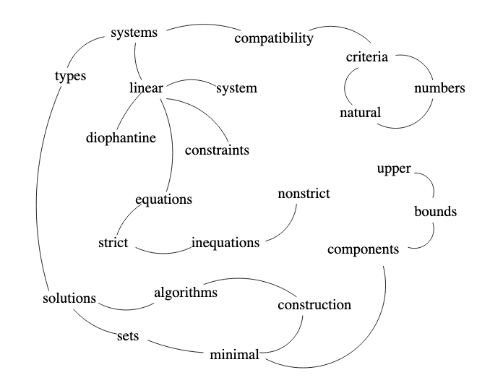
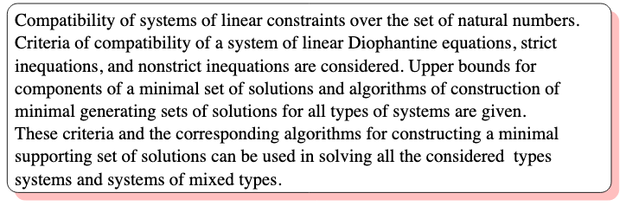
Поиск связей. Text Rank

Slide 28
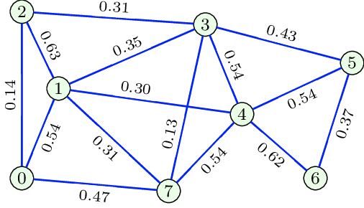
Text Rank
def similarity(sent_1, sent_2):
return len(word in sent_2 for word in sent_1) \
/ len(sent_1) / len(sent_2)

